Slide 1

design by contract
sabre .net
community
dariuszwozniak.net
kraków
sep 9
2014
Notes:
pl:
asercje
- warunki poczatkowe
- warunki koncowe
- niezmienniki klas
http://www.cs.put.poznan.pl/dbrzezinski/teaching/po/7%20-%20Programowanie%20przez%20kontrakt.pdf

Slide 2
agenda defensive programming design by contract
What is: Defensive Programming
What is: Design by Contract (DBC) and Code Contracts
Benefits of DBC
History of DBC
Code Contracts in C#
Examples
Live Demo
Summary
Q&A

Slide 3

agenda defensive programming design by contract
Syntax Correctness
Verified by a compiler
Semantic Correctness
Verified in a runtime
Major cause of bugs
Examples:
Count() >= 0
age must be in range [0; 122]
Obj cannot be Null
Notes:
poprawność składniowa
poprawność semantyczna

Slide 4
agenda defensive programming design by contract
Problem:
How to check whether it is NULL or not?
GetRoom(Hotel hotel);
if (hotel == null) throw new ArgumentNullException(”hotel”);
Debug.Assert(hotel != null);
Trace.Assert(hotel != null);
Configurable (DEBUG\RELEASE\etc.)
Compile check
Contract.Requires<ArgumentNullException>(hotel != null, ”hotel”);
Notes:
I've been trained to believe that throwing the ArgumentNullException is "correct" but an "Object reference not set to an instance of an object" error means I have a bug. Why?
Suppose I call method M(x) that you wrote. I pass null. I get an ArgumentNullException with the name set to "x". That exception unambiguously means that I have a bug; I should not have passed null for x.
Suppose I call a method M that you wrote. I pass null. I get a null deref exception. How the heck am I supposed to know whether I have a bug or you have a bug or some third party library that you called on my behalf has a bug? I know nothing about whether I need to fix my code or call you up to tell you to fix yours.
Both exceptions are indicative of bugs; neither should ever be thrown in production code. The question is which exception communicates who has the bug better to the person doing the debugging? Null deref exception tells you almost nothing; argument null exception tells you a lot. Be kind to your users; throw exceptions that enable them to learn from their mistakes.
http://programmers.stackexchange.com/questions/121121/how-does-throwing-an-argumentnullexception-help

Slide 5

agenda defensive programming design by contract
design by contract is a software correctness methodology
it uses preconditions and postconditions to document (or programmatically assert) the change in state caused by a piece of a program
source: http://c2.com/cgi/wiki?DesignByContract

Slide 6
agenda defensive programming design by contract
static (compile-time) and/or runtime checking
precondition
condition checked on entry to method
postcondition
condition checked on exit of method
object invariant
condition that always should be true

Slide 7

benefits history examples summary references
static verification
automatic testing tools
code documentation
contracts as documentation
contracts added to documentation
cleaner code
improved feedback loop
short learning curve

Slide 8
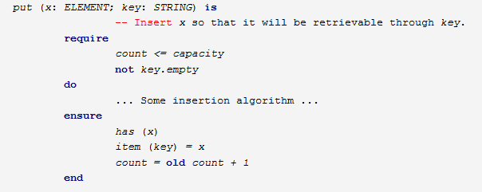

benefits history examples summary references
1986: Eiffel
Notes:
The pre- and postcondition technique originated with the work of TonyHoare, whose 1969 Communications of the ACM paper described program semantics using such assertions. Hoare's 1972 Acta Informatica paper described the use of representation invariants and abstraction functions to prove correctness of abstract data types.
Pre- and postconditions were first supported natively in a language in BarbaraLiskovs CLU (circa 1974 - 1977).

Slide 9
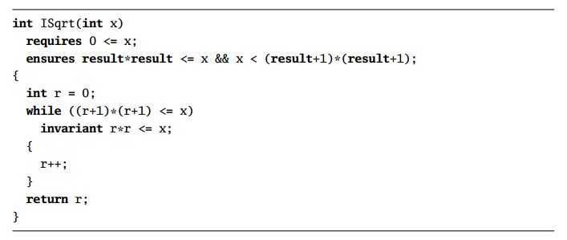

benefits history examples summary references
1986: Eiffel
2004: Spec#

Slide 10
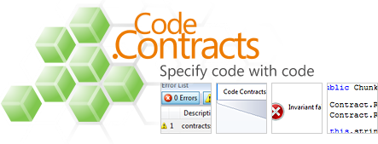
benefits history examples summary references
1986: Eiffel
2008: Code Contracts in .NET
2004: Spec#

Slide 11
benefits history examples summary references
1986: Eiffel
2008: Code Contracts in .NET
2004: Spec#
part of the library since .NET 4.0
static and runtime checking (configurable per project)
inheritable contracts
support for abstract classes and interfaces

Slide 12
benefits history examples summary references
1986: Eiffel
2008: Code Contracts in .NET
2004: Spec#
generate API documentation
hooks into XML documentation and inserts contract requirements (requires, ensures)
automatically suggests missing contracts
resharper support

Slide 13

examples

Slide 14
preconditions
benefits history examples summary references
public int Add(int a, int b)
{
Contract.Requires<ArgumentOutOfRangeException>(a >= 0);
Contract.Requires<ArgumentOutOfRangeException>(b >= 0);
// main logic
}

Slide 15
postconditions
benefits history examples summary references
public int Add(int a, int b)
{
// pre-conditions
Contract.Ensures(Contract.Result<int>() >= 0);
// main logic
}

Slide 16
object invariants
benefits history examples summary references
[ContractInvariantMethod]
private void CheckIfLastResultIsInRange()
{
Contract.Invariant(lastResult >= 0);
}

Slide 17
Preconditions:
Contract.Requires
Contract.EndContractBlock
Postconditions:
Contract.Ensures
Contract.EnsuresOnThrow
Invariants:
[ContractInvariantMethod]
Contract.Invariant
Assert:
Contract.Assert
Assume:
Contract.Assume
Interface and abstract methods:
[ContractClass]
[ContractClassFor]
Quantifiers:
Contract.ForAll
Contract.Exists
Notes:
The Difference between Assert and Assume is that with Assert the static checker tries to prove it, with assume the static checker simply assumes it's true.
So if you have a error in your logic, Assert will warn you about it, Assume will simply ignore it.
[http://social.msdn.microsoft.com/Forums/en-US/f0039acf-cc08-480c-ac5f-01f40345c04d/contractassert-or-contractassume-?forum=codecontracts]

Slide 18
// demo

Slide 19

benefits history examples summary references
defensive programming
software correctness
static and runtime checking of
preconditions
postconditions
object invariants
documents and asserts changes in a state of a program

Slide 20
benefits history examples summary references
MSDN: Code Contracts http://msdn.microsoft.com/en-us/library/dd264808%28v=vs.110%29.aspx
Using the Spec# Language, Methodology, and Tools to Write Bug-Free Programs [2009]
Mike Frederick: Code Contracts in .NET 4 — SVNUG Presentation [December 2011]
Code Contracts is the next coding practice you should learn and use http://codebetter.com/patricksmacchia/2013/12/18/code-contracts-is-the-next-coding-practice-you-should-learn-and-use/
Clarence Bakirtzidis: Code Contracts API In .NET
http://c2.com/cgi/wiki?DesignByContract
Jon Skeet: C# in Depth (2nd ed.)

Slide 21

questions

Slide 22



thank you
github.com/dariusz-wozniak/dbc-demo
dariusz.wozniak@sabre.com
dariuszwozniak.net

